Slide 1

March 28, 2022
Budget Presentation to the Board of Trustees

Slide 2


Slide 3
BUDGET BALANCE - 2020/2021
Average Village Tax = $831 per household

Slide 4
Revenue by Category
 | 2022/23 |  |  |  | 2021/22
Revenue by Category | Proposed Tentative Budget 2022/2023 | % of Total Budget | Difference | % Increase/ Decrease | Prior Year 2021/2022 | % of Total Budget
REAL PROPERTY TAXES & TAX ITEMS | $1,980,890 | 46% | $29,275 | 1.5% | $1,951,615 | 45%
NON-PROPERTY TAXES | $275,000 | 6% | $0 | 0% | $275,000 | 6%
HOME & COMMUNITY SERVICE | $60,000 | 1% | $500 | 1% | $59,500 | 1%
USE OF MONEY & PROPERTY | $7,900 | 0% | $2,500 | 32% | $5,400 | 0%
LICENSES & PERMITS | $719,700 | 17% | -$114,800 | -16% | $834,500 | 19%
FINES & FORFEITURES | $45,000 | 1% | $0 | 0% | $45,000 | 1%
MISCELLANEOUS | $31,000 | 1% | -$3,775 | -12% | $34,775 | 1%
STATE AID | $888,000 | 21% | -$20,000 | -2% | $908,000 | 21%
APPROPRIATED FUND BALANCE/TRANSFER FUNDS | $265,283 | 6% | $54,819 | 21% | $210,464 | 5%
TOTAL BUDGET | $4,272,773 |  | -$51,481 | -1% | $4,324,254

Slide 5
Revenue by Category

Slide 6
Expense by Category
 | 2022/23 |  |  |  |  | 2021/22
EXPENSES BY CATEGORY | Proposed Tentative Budget 2022/2023 | % of Total Budget | % of Total Budget Less Fire | Difference | % Increase/ Decrease | Prior Year 2021/2022 | % of Total Budget
LEGISLATIVE | $450 | 0.0% | 0.0% | -$250 | -56% | $700 | 0.0%
JUDICIAL | $77,986 | 1.8% | 2.2% | $2,594 | 3% | $75,392 | 1.7%
EXECUTIVE | $600 | 0.0% | 0.0% | $0 | 0% | $600 | 0.0%
FINANCE | $35,450 | 0.8% | 1.0% | -$5,550 | -16% | $41,000 | 0.9%
STAFF/CLERK CONT. | $499,763 | 11.7% | 14.1% | $137,856 | 28% | $361,907 | 8.4%
LEGAL/OTHER | $110,000 | 2.6% | 3.1% | $0 | 0% | $110,000 | 2.5%
SHARED SERVICES | $153,075 | 3.6% | 4.3% | $6,875 | 4% | $146,200 | 3.4%
SPECIAL ITEMS | $149,500 | 3.5% | 4.2% | -$178,500 | -119% | $328,000 | 7.6%
CODE ENFORCEMENT | $91,455 | 2.1% | 2.6% | $3,150 | 3% | $88,305 | 2.0%
FIRE PREVENTION | $734,809 | 17.2% |  | $4,454 | 1% | $730,355 | 16.9%
BUILDING DEPT | $250,082 | 5.9% | 7.1% | $52,095 | 21% | $197,987 | 4.6%
HIGHWAY | $618,103 | 14.5% | 17.5% | -$120,705 | -20% | $738,808 | 17.1%
ECONOMIC ASSISTANCE & OPPORTUNITY | $73,000 | 1.7% | 2.1% | -$45,000 | -62% | $118,000 | 2.7%
SANITATION | $902,000 | 21.1% | 25.5% | $2,000 | 0% | $900,000 | 20.8%
EMPLOYEE BENEFITS | $476,500 | 11.2% | 13.5% | -$10,500 | -2% | $487,000 | 11.3%
TRANSFER TO CAPITAL RESERVE | $100,000 | 2.3% | 2.8% | $100,000 | 0% | $0 | 0.0%
TOTAL BUDGET | $4,272,773 |  |  | -$51,481 | -1% | $4,324,254

Slide 7
Expense by Category

Slide 8
Expense by Category Excluding Fire

Slide 9
Capital Assets
Asset | Manufacturer | Model | Model Year | Year Acquired | Original Cost | Expected Life (Years) | Estimated Replacement Date
Large Dump Truck | Kenworth | T-37050 | 2020 | 2020 | $ 241,307 | 10 | 2030
Dump Truck | Ford | F-450 | 2011 | 2011 | $ 42,929 | 10 | 2021
Pickup Truck | Ford | F-250 | 2011 | 2012 | $ 28,133 | 8 | 2020
Pickup Truck | Ford | F-250 | 2005 | 2005 | $ 26,950 | 8 | 2013
Payloader | Kawasaki | 60 Z IV | 2001 | 2001 | $ 72,900 | 10 | 2011
Street Sweeper | Internatational | Street Sweeper | 2012 | 2013 | $ 192,612 | 10 | 2023
SUV | Ford | Escape | 2010 | 2011 | $ 18,998 | 8 | 2019
Arrow Board | Vermac |  | 2019 | 2019 | $ 4,000 | 10 | 2029
Trailer | Stow Mfg | T-3000 | 1999 | 1999 | $ 2,000 | 10 | 2009
Golf cart | EZ Go |  | 2007 | 2007 | $ 8,400 | 15 | 2022
Ride on Lawnmower | Scag | ZCAT | 2005 | 2005 | $ 4,800 | 15 | 2020
Ride on Lawnmower | Bobcat | 110512 | 2014 | 2014 | $ 7,000 | 15 | 2029
Lawnmower | Bunton | 630007 | 2000 | 2000 | $ 2,600 | 15 | 2015

Slide 10
Capital Reserve Funds
Saving for the Future
Capital Equipment | Capital Projects
Replacement Pickup Truck | Road Repaving
Skid Steer | Park Walkway Repaving
Road Brining Equipment | Park Walkway Expansion
Replacement Payloader | Road Improvements
Technology Updates | Park Improvements

Slide 11
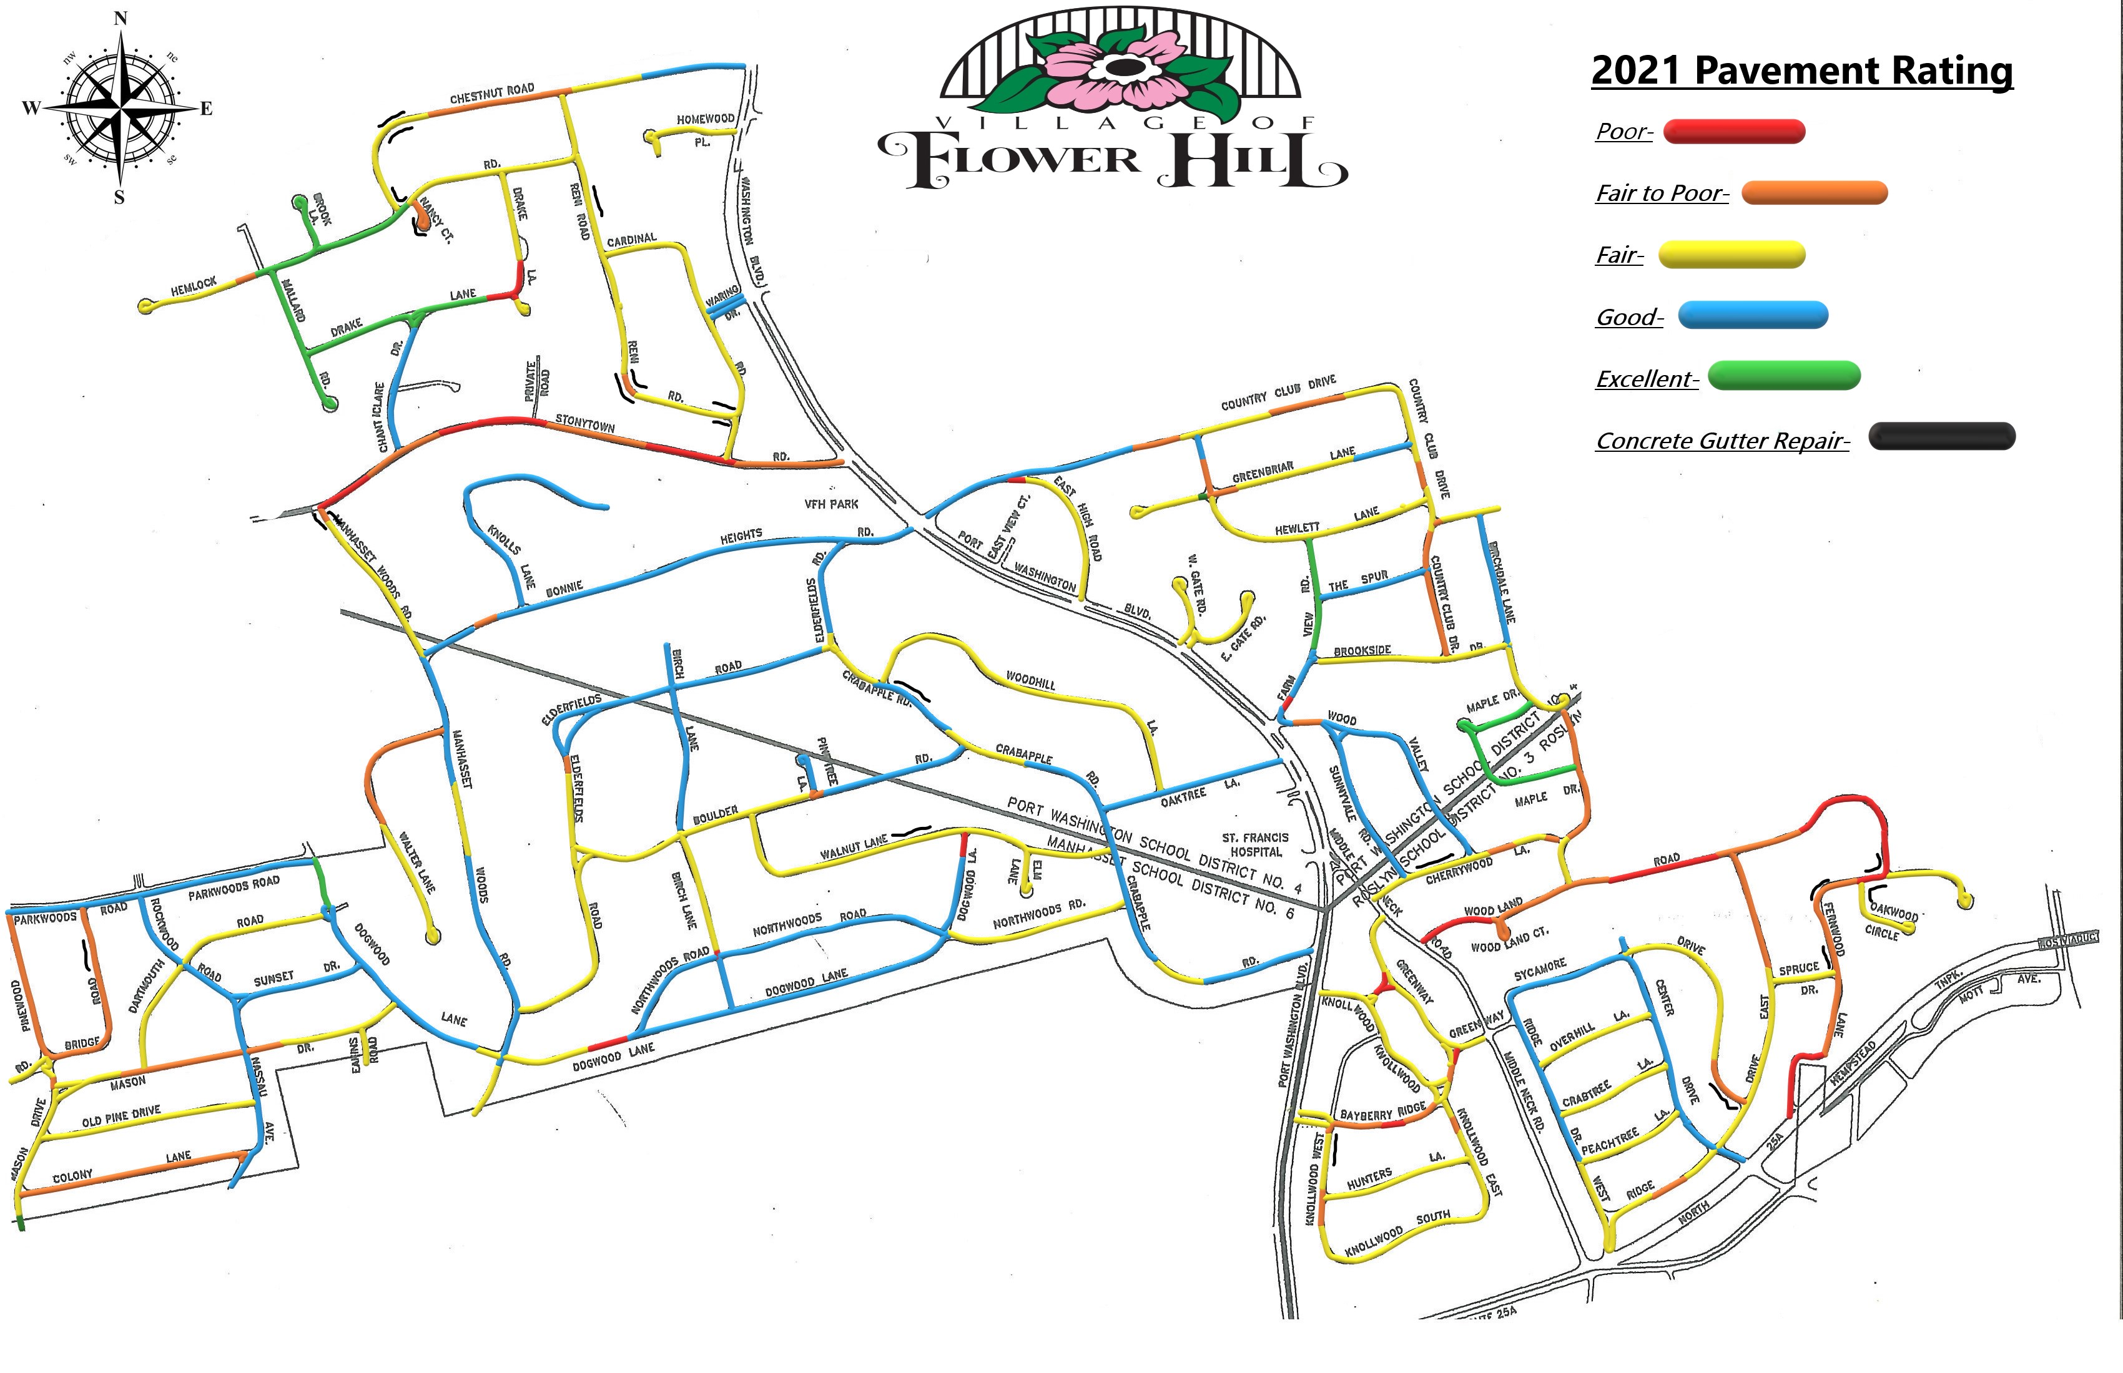
Road Conditions Map

